Slide 1






SU² Design Exploration NACA 0012
SU² Release Version 2.0 Workshop
Stanford University
Tuesday, January 15th, 2013
Trent Lukaczyk
Department of Aeronautics & Astronautics
Stanford University

Slide 2
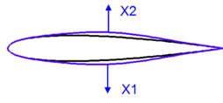
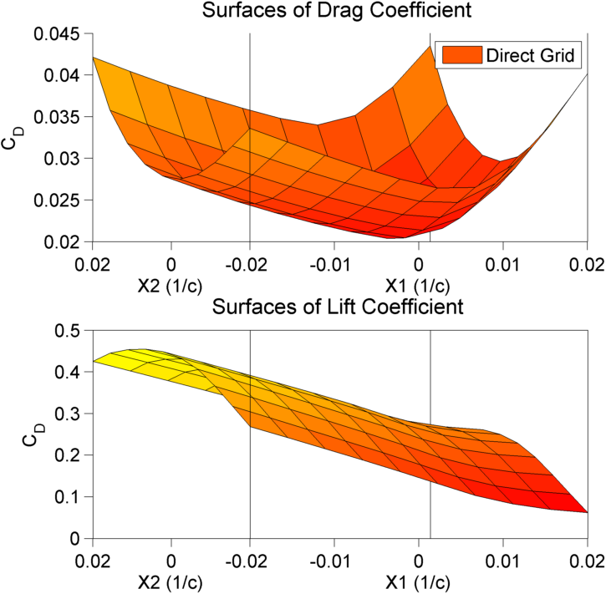
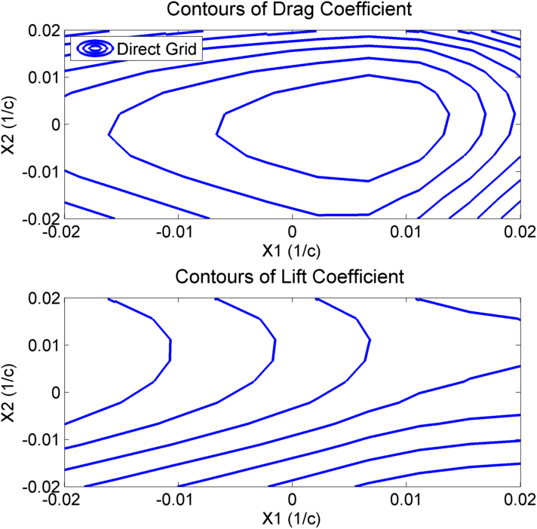
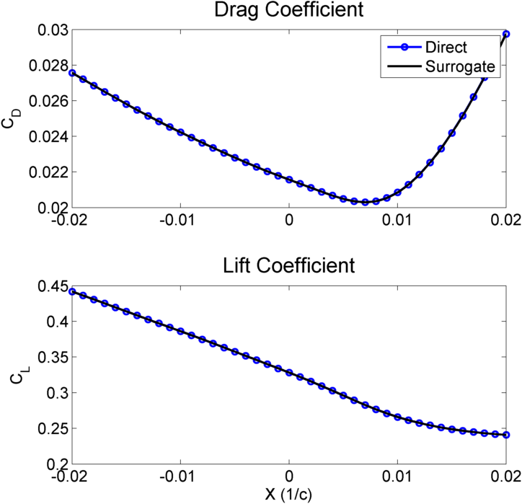
Indirect Design Approaches
Example: Response Surface Modeling
Two Hicks-Henne Bump Functions
10x10 grid of simulations
2

Slide 3
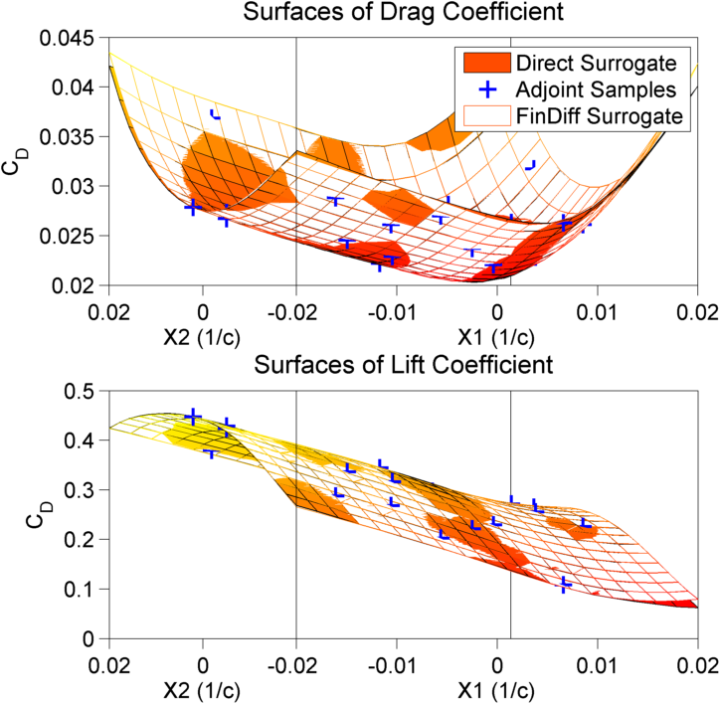
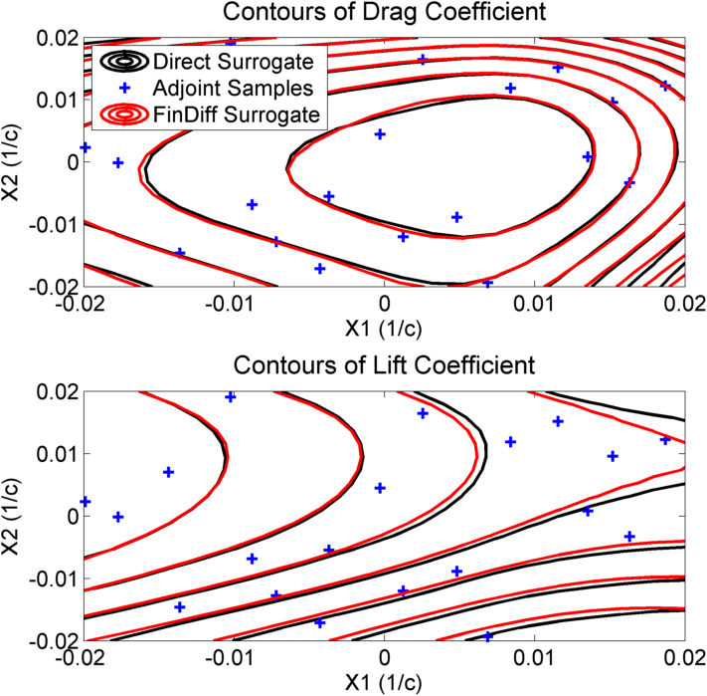
Indirect Design Approaches
Example: Response Surface Modeling
Two Hicks-Henne Bump Functions
10x10 grid of simulations
3

Slide 4
Task-Based Design Exploration
* Only design variables for now
Project
Root folder of data Baseline config and mesh
Config Change
Config Change
Config Change
Job 0
Job 1
Job 2
Contains analysis tasks Output meshes, restarts
Task Deformation
Task Direct Solution
Task Drag Adjoint
Task Lift Adjoint
4

Slide 5
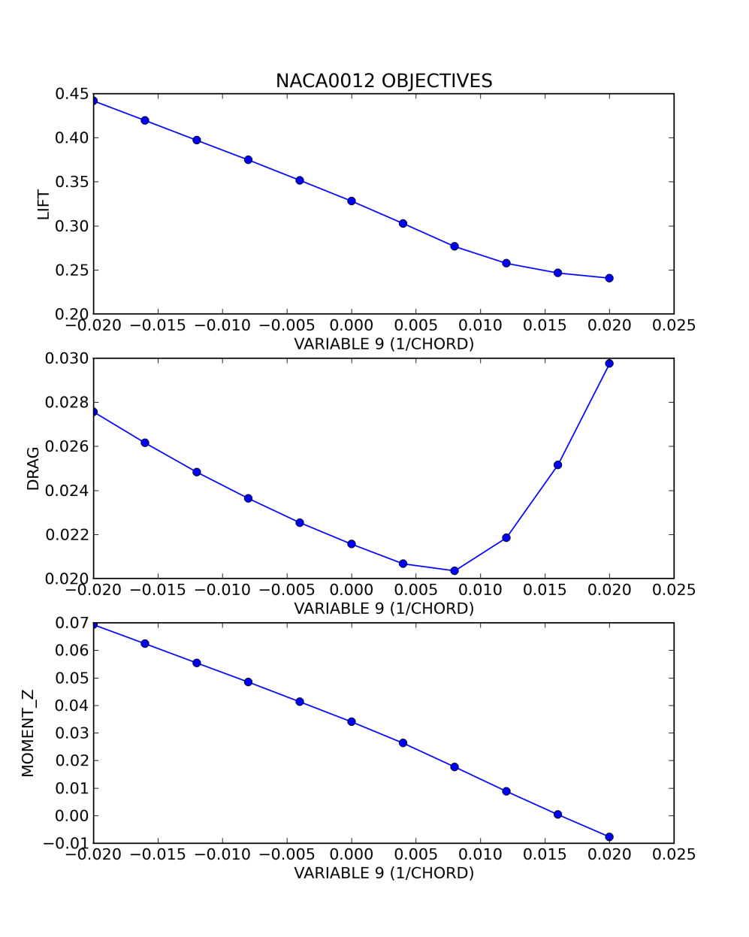

NACA0012 Test Case
NACA 0012 Test Case
One Hicks-Henne Bump Function
11 Evaluations in X ϵ [-0.02 , 0.02]
5
Notes:
Describe the test case
Plot with matplotlib
Liberate to matlab with scipy
Find the files located in the testcases directory
Copy to a new location

Slide 6
config_NACA0012.cfg
% ------------------------- EVALUATE PROJECT DEFINITION ------------------------%
% List of tasks to complete
TASKS= DEFORM, DIRECT, CONT_ADJOINT
% Number of partitions (0 for Serial)
NUMBER_PART= 2
% List of design variables (Design variables are separated by semicolons)
% - HICKS_HENNE: ( 1, Scale | Mark. List | Lower(0)/Upper(1) side, x_Loc )
DEFINITION_DV= ( 1, 1.0 | airfoil | 0, 0.05 ); ( 1, 1.0 | airfoil | 0, 0.10 ); (...)
% Gradients to calculate
GRADIENTS= LIFT, DRAG, MOMENT_Z
% Console output (VERBOSE, CONCISE, QUIET)
CONSOLE= CONCISE
6
Notes:
Open config_NACA0012.cfg

Slide 7
config_NACA0012.cfg
% ------------------------- EVALUATE PROJECT DEFINITION ------------------------%
% List of tasks to complete
TASKS= DEFORM, DIRECT, CONT_ADJOINT
% Number of partitions (0 for Serial)
NUMBER_PART= 2
% List of design variables (Design variables are separated by semicolons)
% - HICKS_HENNE: ( 1, Scale | Mark. List | Lower(0)/Upper(1) side, x_Loc )
DEFINITION_DV= ( 1, 1.0 | airfoil | 0, 0.05 ); ( 1, 1.0 | airfoil | 0, 0.10 ); (...)
% Gradients to calculate
GRADIENTS= LIFT, DRAG, MOMENT_Z
% Console output (VERBOSE, CONCISE, QUIET)
CONSOLE= CONCISE
7

Slide 8
config_NACA0012.cfg
% ------------------------- EVALUATE PROJECT DEFINITION ------------------------%
% List of tasks to complete
TASKS= DEFORM, DIRECT, CONT_ADJOINT
% Number of partitions (0 for Serial)
NUMBER_PART= 2
% List of design variables (Design variables are separated by semicolons)
% - HICKS_HENNE: ( 1, Scale | Mark. List | Lower(0)/Upper(1) side, x_Loc )
DEFINITION_DV= ( 1, 1.0 | airfoil | 0, 0.05 ); ( 1, 1.0 | airfoil | 0, 0.10 ); (...)
% Gradients to calculate
GRADIENTS= LIFT, DRAG, MOMENT_Z
% Console output (VERBOSE, CONCISE, QUIET)
CONSOLE= CONCISE
8

Slide 9
config_NACA0012.cfg
% ------------------------- EVALUATE PROJECT DEFINITION ------------------------%
% List of tasks to complete
TASKS= DEFORM, DIRECT, CONT_ADJOINT
% Number of partitions (0 for Serial)
NUMBER_PART= 2
% List of design variables (Design variables are separated by semicolons)
% - HICKS_HENNE: ( 1, Scale | Mark. List | Lower(0)/Upper(1) side, x_Loc )
DEFINITION_DV= ( 1, 1.0 | airfoil | 0, 0.05 ); ( 1, 1.0 | airfoil | 0, 0.10 ); (...)
% Gradients to calculate
GRADIENTS= LIFT, DRAG, MOMENT_Z
% Console output (VERBOSE, CONCISE, QUIET)
CONSOLE= CONCISE
9

Slide 10
config_NACA0012.cfg
% ------------------------- EVALUATE PROJECT DEFINITION ------------------------%
% List of tasks to complete
TASKS= DEFORM, DIRECT, CONT_ADJOINT
% Number of partitions (0 for Serial)
NUMBER_PART= 2
% List of design variables (Design variables are separated by semicolons)
% - HICKS_HENNE: ( 1, Scale | Mark. List | Lower(0)/Upper(1) side, x_Loc )
DEFINITION_DV= ( 1, 1.0 | airfoil | 0, 0.05 ); ( 1, 1.0 | airfoil | 0, 0.10 ); (...)
% Gradients to calculate
GRADIENTS= LIFT, DRAG, MOMENT_Z
% Console output (VERBOSE, CONCISE, QUIET)
CONSOLE= CONCISE
10

Slide 11
config_NACA0012.cfg
% ------------------------- EVALUATE PROJECT DEFINITION ------------------------%
% List of tasks to complete
TASKS= DEFORM, DIRECT, CONT_ADJOINT
% Number of partitions (0 for Serial)
NUMBER_PART= 2
% List of design variables (Design variables are separated by semicolons)
% - HICKS_HENNE: ( 1, Scale | Mark. List | Lower(0)/Upper(1) side, x_Loc )
DEFINITION_DV= ( 1, 1.0 | airfoil | 0, 0.05 ); ( 1, 1.0 | airfoil | 0, 0.10 ); (...)
% Gradients to calculate
GRADIENTS= LIFT, DRAG, MOMENT_Z
% Console output (VERBOSE, CONCISE, QUIET)
CONSOLE= CONCISE
11

Slide 12
run_project.py
# Setup
(…)
# design variable values
DV_vals = numpy.linspace(-0.02,0.02, 11 )
# setup config changes
config_delta = []
for X in DV_vals:
DV_X = numpy.zeros(n_DV)
DV_X[i_DV] = X
config_delta.append( {'VARIABLES':DV_X} )
# initialize project
The_Project = Project( config_name = config_filename ,
design_name = design_filename )
12

Slide 13
run_project.py
# Setup
(…)
# design variable values
DV_vals = numpy.linspace(-0.02,0.02, 11 )
# setup config changes
config_delta = []
for X in DV_vals:
DV_X = numpy.zeros(n_DV)
DV_X[i_DV] = X
config_delta.append( {'VARIABLES':DV_X} )
# initialize project
The_Project = Project( config_name = config_filename ,
design_name = design_filename )
13

Slide 14
run_project.py
# Setup
(…)
# design variable values
DV_vals = numpy.linspace(-0.02,0.02, 11 )
# setup config changes
config_delta = []
for X in DV_vals:
DV_X = numpy.zeros(n_DV)
DV_X[i_DV] = X
config_delta.append( {'VARIABLES':DV_X} )
# initialize project
The_Project = Project( config_name = config_filename ,
design_name = design_filename )
List of Variable Settings:
[ {‘VARIABLES’:-0.020} ,
{‘VARIABLES’:-0.018} ,
…
{‘VARIABLES’:+0.020} ]
14

Slide 15
run_project.py
# Setup
(…)
# design variable values
DV_vals = numpy.linspace(-0.02,0.02, 11 )
# setup config changes
config_delta = []
for X in DV_vals:
DV_X = numpy.zeros(n_DV)
DV_X[i_DV] = X
config_delta.append( {'VARIABLES':DV_X} )
# initialize project
The_Project = Project( config_name = config_filename ,
design_name = design_filename )
15

Slide 16
run_project.py
# Run Project
# evaluate project
design_new,_,_ = The_Project.evaluate(config_delta)
# save project
libSU2.save_data(project_filename,The_Project)
# save data
# already done by The_Project.evaluate()
16

